Slide 1




Delegates and Events
Callback Functionality and Event-Driven Programming
OOP
SoftUni Team
Technical Trainers
Software University
http://softuni.bg

Slide 2

Table of Contents
What are Delegates?
Generic Delegates
Action<T> and Func<T, TResult>
Anonymous Methods
Predicates
Events and Event Handlers
Events vs. Delegates

Slide 3
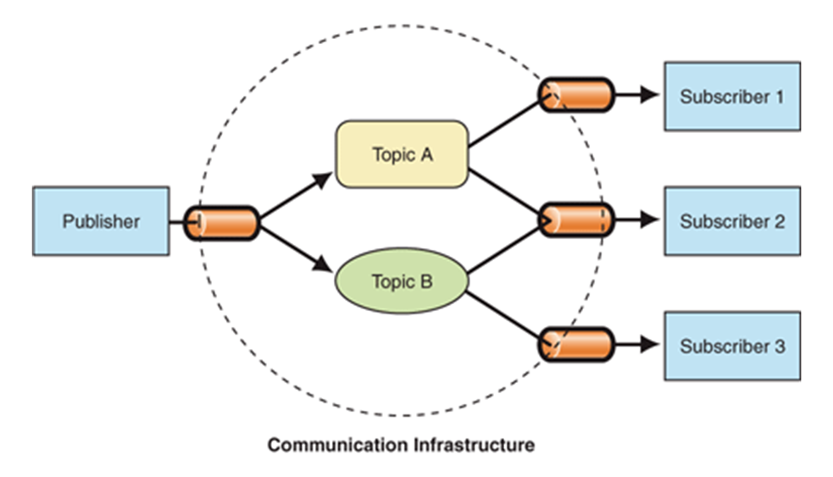
What are Delegates?

Slide 4
What are Delegates?
Delegates are special C# types that hold a method reference
A data type holding a function (method) as its value
Describe the parameters accepted and return value (method signature)
Delegates are similar to function pointers in C and C++
Strongly-typed pointer (reference) to a method
Pointer (address) to a callback function
In JavaScript any variable can hold a function
In C# only variable of type delegate can hold a function

Slide 5
What are Delegates? (2)
Can point to static and instance methods
Can point to a sequence of multiple methods
Used to perform callbacks invocations
Used to implement the "publish-subscribe" model
Components publish their events
E.g. Button publishes Click and MouseOver events
Other components subscribe to events
E.g. LoginForm subscribes to LoginButton.Click

Slide 6
Delegates – Example
// Declaration of a delegate
public delegate void SimpleDelegate(string param);
public class DelegatesExample
{
public static void TestMethod(string param)
{
Console.WriteLine("I was called by a delegate.");
Console.WriteLine("I got parameter {0}.", param);
}
public static void Main()
{
// Instantiate the delegate
SimpleDelegate d = new SimpleDelegate(TestMethod);
// Invocation of the method, pointed by delegate
d("test");
}
}

Slide 7
Simple Delegate
Live Demo

Slide 8
Delegates are Multicast
delegate int StringDelegate<T>(T value);
public class MultiDelegates
{
static int PrintString(string str)
{
Console.WriteLine("Str: {0}", str);
return 1;
}
int PrintStringLength(string value)
{
Console.WriteLine("Length: {0}", value.Length);
return 2;
}
public static void Main()
{
StringDelegate<string> d = MultiDelegates.PrintString;
d += new MultiDelegates().PrintStringLength;
int result = d("some string value");
Console.WriteLine("Returned result: {0}", result);
}
}

Slide 9


Multicast Delegates
Live Demo

Slide 10
Generic Delegates
A delegate can be generic:
C# has a feature called implicit method group conversion
Applies to all delegate types
Enables you to write the previous line with this simplified syntax:
public delegate void SomeDelegate<T>(T item);
public static void Notify(int i) { }
SomeDelegate<int> d = new SomeDelegate<int>(Notify);
SomeDelegate<int> d = Notify;

Slide 11
Predefined Delegates: Action and Func
Predefined delegates in .NET:
Action<T1, T2, T3> – generic predefined void delegate
Func<T1, T2, TResult> – generic predefined delegate with return value of type TResult
Examples:
Func<string, int> intParseFunction = int.Parse;
int num = intParseFunction("10");
Action<int> printNumberAction = Console.WriteLine;
printNumberAction(num);

Slide 12
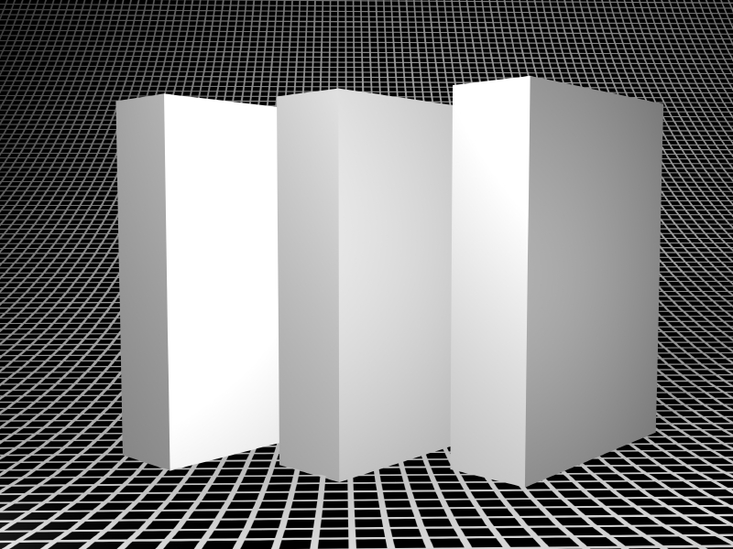

Action<T> and Func<T, Result>
Live Demo

Slide 13


Anonymous Methods
Definition and Parameters

Slide 14
Anonymous Methods
Often a class / method is created just for the sake of using a delegate
The code involved is often relatively short and simple
Anonymous methods let you define a nameless method called by a delegate
Lambda functions are a variant of anonymous methods with shorter syntax

Slide 15
Delegates: The Standard Way
class InvokeDelegateExample
{
static void SomeMethod(string msg)
{
Console.WriteLine(msg);
}
static void Main()
{
Action<string> action = SomeMethod;
action("Pesho");
}
}
A delegate holds a method as its value

Slide 16
Using Anonymous Methods
A delegate holds an anonymous method as its value
class AnnonymousMethodExample
{
static void Main()
{
Action<string> action = delegate(string msg)
{
MessageBox.Show(msg);
};
action("Pesho");
}
}

Slide 17
Using Lambda Expression
A delegate holds a lambda function as its value
class LambdaExpressionExample
{
static void Main()
{
Action<string> action = ((msg) =>
{
MessageBox.Show(msg);
});
action("Prakash");
}
}

Slide 18

Anonymous Methods
Live Demo

Slide 19

Predicates
Predefined Boolean Delegates

Slide 20
Predicates
Predicates are predefined delegates with the following signature
Define a way to check if an object meets some Boolean criteria
Used by many methods in Array and List<T> to search for an element
For example IList<T>.FindAll(Predicate<T>) retrieves all elements meeting the criteria defined by the predicate
public delegate bool Predicate<T>(T obj)

Slide 21
Predicates – Example
List<string> towns = new List<string>()
{
"Sofia", "Burgas", "Plovdiv", "Varna",
"Ruse", "Sopot", "Silistra"
};
List<string> townsWithS =
towns.FindAll(delegate(string town)
{
return town.StartsWith("S");
});
foreach (string town in townsWithS)
{
Console.WriteLine(town);
}

Slide 22
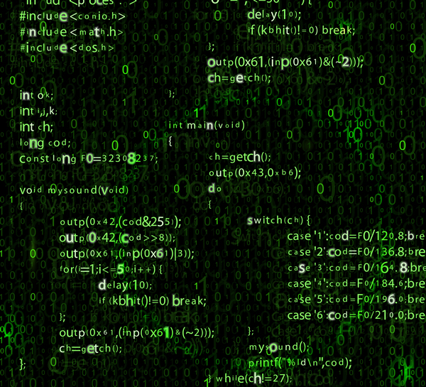
Predicates
Predicates
Live Demo

Slide 23
Custom LINQ Extensions – Example
public static IEnumerable<T> Filter<T>(
this IEnumerable<T> collection, Predicate<T> filterPredicate)
{
var matches = new List<T>();
foreach (var element in collection)
{
if (filterPredicate(element))
{
matches.Add(element);
}
}
return matches;
}
int evenNumbers = source
.Filter(n => n % 2 == 0);

Slide 24
Custom LINQ Extensions – Example (2)
public static IEnumerable<K> Project<T, K>(
this IEnumerable<T> collection, Func<T, K> selectFunc)
{
var list = new List<K>();
foreach (var element in collection)
{
K projectedElement = selectFunc(element);
list.Add(projectedElement);
}
return list;
}
int studentNames = source
.Project(st => st.Name);

Slide 25



Custom LINQ Extension Methods
Filter(Predicate<T>…)
Live Demo

Slide 26
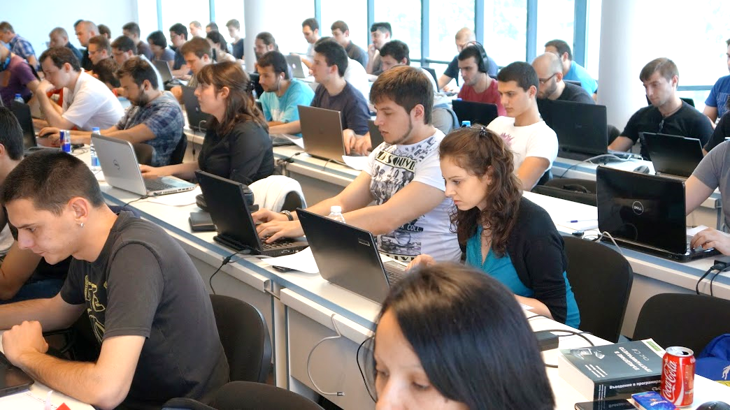
Exercise in Class

Slide 27
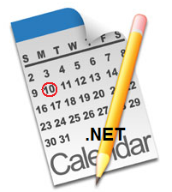
Events

Slide 28
Events
In component-oriented programming components publish events to other components
Events notify that something has happened
E.g. moving the mouse causes an event
The object which causes an event is called event sender
The object which receives an event is called event receiver
In order to receive an event, the event receivers should first "subscribe to the event"

Slide 29
Events in .NET
Events in C# are special delegate instances declared by the keyword event
In the component model of .NET the
subscription
sending
receiving
of events is supported through delegates and events
public event SomeDelegate eventName;

Slide 30
Events in .NET (2)
The C# compiler automatically defines the += and -= operators for events
+= subscribes for an event
-= unsubscribes for an event
No other operations are allowed
Events can redefine the code for subscription and unsubscription

Slide 31
Events vs. Delegates
Events are not the same as member fields of type delegate
Events can be members of an interface
Delegates cannot
An event can only be called in the class where it is defined
By default the access to the events is synchronized (thread-safe)
≠
public Action<string> m;
public event Action<string> m;

Slide 32
The System.EventHandler Delegate
System.EventHandler defines a reference to a callback method, which handles events
No additional information is sent about the event, just a notification:
Used in many occasions internally in .NET
The EventArgs class is the base class with no information for the event
public delegate void EventHandler(object sender, EventArgs e);

Slide 33
The System.EventHandler Delegate (2)
public class Button
{
public event EventHandler Click;
public event EventHandler GotFocus;
public event EventHandler TextChanged;
...
}
public class ButtonExample
{
private static void OnButtonClick(object sender, EventArgs eventArgs)
{
Console.WriteLine("OnButtonClick() event called.");
}
public static void Main()
{
Button button = new Button();
button.Click += new EventHandler(OnButtonClick);
}
}

Slide 34

The System.EventHandler Delegate
Live Demo

Slide 35
Custom Events: Convention
.NET defines a convention (pattern) for defining events:
http://msdn.microsoft.com/en-us/library/aa645739(v=vs.71).aspx
Delegates which are used for events:
Have names formed by a verb + EventHandler
Accept two parameters:
Event sender – System.Object
Event information – inherited from System.EventArgs
No return value (void)

Slide 36
Custom Events: Convention (2)
Example:
Events:
Are declared public
Follow PascalCase naming convention
End with a verb
public delegate void ItemChangedEventHandler(
object sender, ItemChangedEventArgs eventArgs);
public event ItemChangedEventHandler ItemChanged;

Slide 37
Custom Events: Convention (3)
To fire an event a special protected void method is created
Named after a specific action, e.g. OnVerb()
The receiver method (handler) is named in the form OnObjectEvent:
protected void OnItemChanged()
{
…
}
private void OnOrderListItemChanged()
{
…
}

Slide 38
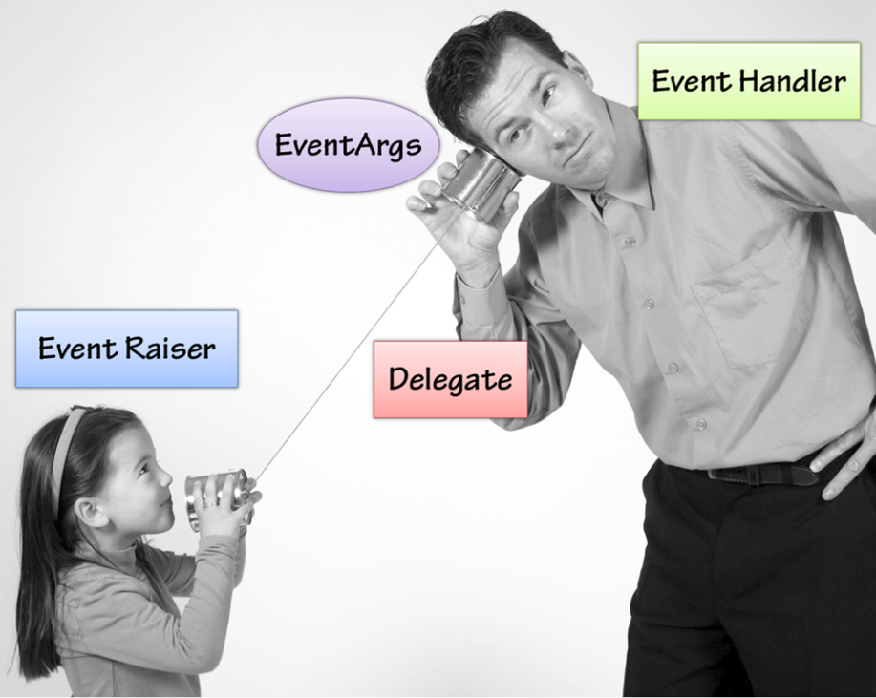
Defining and Using Events
Live Demo

Slide 39
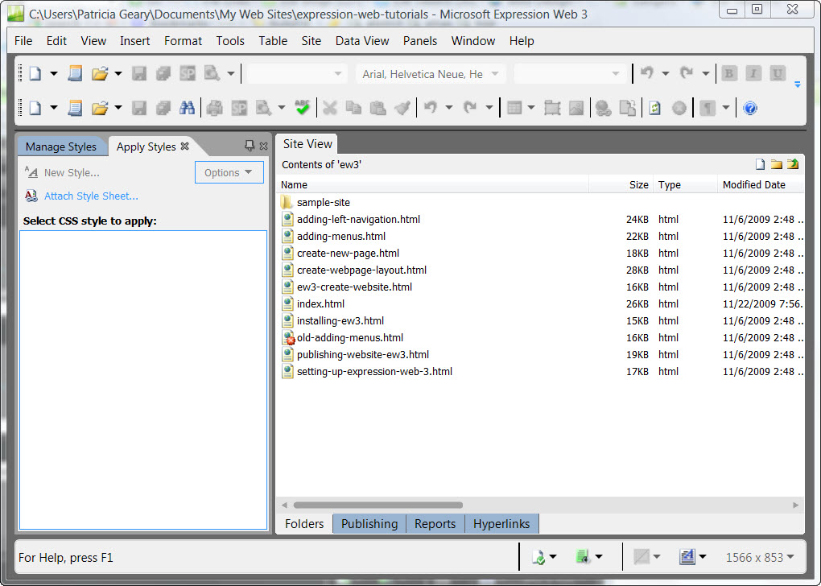
Events in User Interfaces

Slide 40
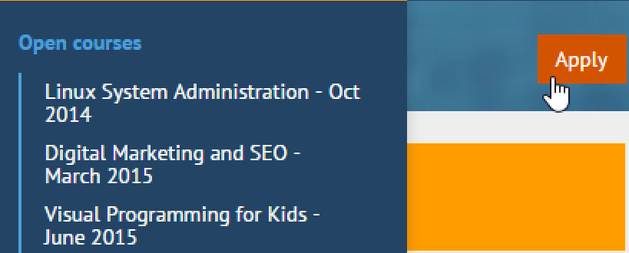
Events in User Interfaces
Events are widely used in Graphical User Interfaces (GUIs)
Components such as buttons define a set of events (OnClick, OnFocus, OnChange, etc)
External components can subscribe (listen) to a specific event and react to it
var button = GetButtonById("btn");
button.OnClick += (sender, args) =>
{
// Code will be executed when button is clicked
};

Slide 41
UI Mouse Click Event Handler – Example
public partial class MainWindow : Window
{
public MainWindow()
{
this.InitializeComponent();
this.MouseDown += this.MainWindow_MouseClick;
}
private void MainWindow_MouseClick(object sender, MouseButtonEventArgs e)
{
MessageBox.Show(string.Format("Mouse clicked at ({0}, {1})",
e.MouseDevice.GetPosition(this).X,
e.MouseDevice.GetPosition(this).Y));
}
}
Receives info about the click as MouseButtonEventArgs

Slide 42
Event Loop
UI technologies usually have an event loop running
Waits for events from the underlying operating system and notifies the respective components
while (message != "quit")
{
// Blocking operation - waits for an event from OS
message = GetMessage();
ProcessMessage(message);
}
Wait for events
Handle events

Slide 43
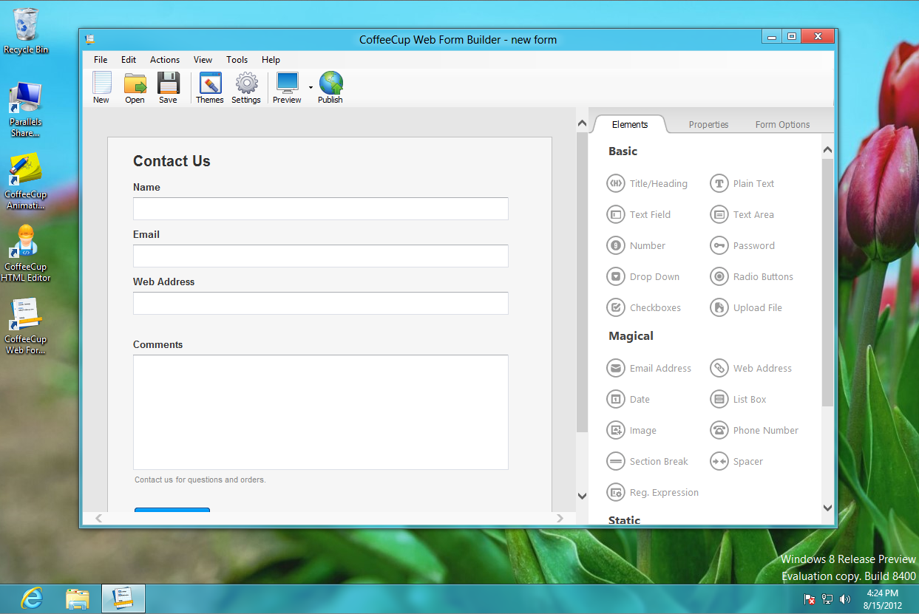
Real-World UI Events
Live Demo

Slide 44
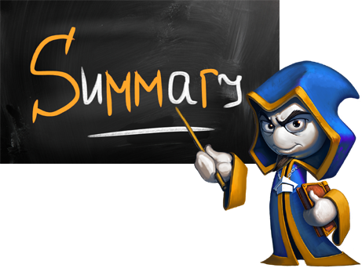
Summary
Delegates are data types that hold methods as their value
Generic delegates in C#
Action<T>, Func<T, TResult> and Predicate<T>
Anonymous methods simplify coding
Events allow subscribing for notifications about something happening in an object
When an event "happens", all subscribers are notified

Slide 45








OOP – Delegates and Events
httpshttps://softuni.bg/courses/oop/

Slide 46

License
This course (slides, examples, demos, videos, homework, etc.) is licensed under the "Creative Commons Attribution-NonCommercial-ShareAlike 4.0 International" license
Attribution: this work may contain portions from
"Fundamentals of Computer Programming with C#" book by Svetlin Nakov & Co. under CC-BY-SA license
"OOP" course by Telerik Academy under CC-BY-NC-SA license

Slide 47






Free Trainings @ Software University
Software University Foundation – softuni.org
Software University – High-Quality Education, Profession and Job for Software Developers
softuni.bg
Software University @ Facebook
facebook.com/SoftwareUniversity
Software University @ YouTube
youtube.com/SoftwareUniversity
Software University Forums – forum.softuni.bg

